Slide 1

Module 10: Administering Siebel Analytics Web
0/5
Analytics: Advanced Application Developer

Slide 2
Module Objectives
After completing this module you will be able to:
  Make general configuration changes using instanceconfig.xml
  Administer Siebel Answers using instanceconfig.xml
  Administer Siebel Answers using XML message files
Why you need to know:
  An understanding of these topics will improve your ability to override general default parameters and internal default settings

Slide 3

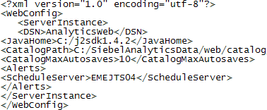

Making Configuration Changes Using instanceconfig.xml
Make changes to instanceconfig.xml message file to override default parameters
Instanceconfig.xml located in \\SiebelAnalyticsData\Web\Config
1. Navigate to \\SiebelAnalyticsData\Web\Config
2. Make backup copy of instanceconfig.xml
3. Open instanceconfig.xml with text editor
4. Make changes between ServerInstance tags
5. Save file
6. Restart Siebel Analytics Web service

Slide 4
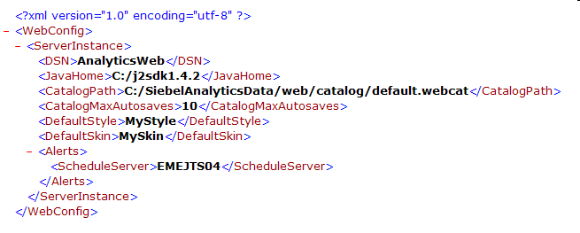
Example Instanceconfig.xml
Several entries are present by default
  Path to Siebel Analytics Web Catalog
  Siebel Analytics Server ODBC data source name (DSN)
Add custom entries as needed
DSN
Web catalog path
Custom entry

Slide 5
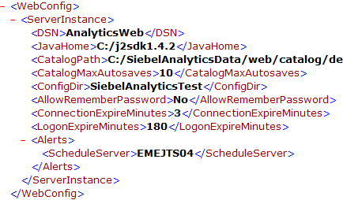
Sample Configuration Changes
Use instanceconfig.xml to override general default parameters and internal default settings for Siebel Analytics Web
Configuration file path
Remember user name and password
Time to expire for idle connections
Time to log off users automatically

Slide 6
Administering Siebel Answers Using Instanceconfig.xml
0/3
Use instanceconfig.xml to override specific default parameters and internal default settings for Siebel Answers
Examples:
  Maximum number of pivot table records
  Maximum number of pivot table populated cells
  Maximum number of table view rows

Slide 7
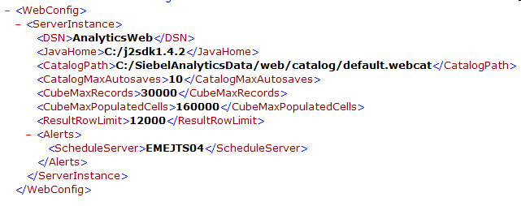
Maximum Number of Pivot Table Records
1/3
Override the maximum number of rows that can be processed by a pivot table
  Internal default is 20,000
  If user exceeds value, server returns error when pivot table is rendered

Slide 8
Maximum Number of Pivot Table Populated Cells
2/3
Override the maximum number of populated cells that Siebel Analytics Web allows in a pivot table
  Internal default is 150,000
  If user exceeds value, server returns error when pivot table is rendered

Slide 9
Maximum Number of Table View Rows
3/3
Override the maximum number of rows that appear in a table view
  Internal default is 10,000
  If user exceeds value, server returns error when table is rendered

Slide 10
Administering Siebel Answers Using XML Message Files
Customize XML message files to control:
  Aspects of the initial state of views added to requests
  New objects added to a dashboard
Use known techniques to customize XML message files

Slide 11

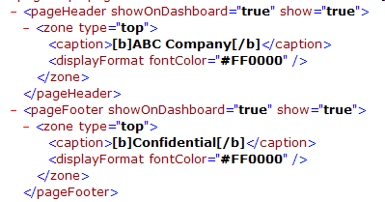


Example: Adding Header and Footer to New Reports
Create an XML message specifying that default headers and footers appear on all new reports
  Include information like confidentiality notice, company name, etc.
1. Create custom XML message file (file name is arbitrary)
2. Change header and footer text in custom XML message file
3. Place custom message file in CustomMessages folder
4. Restart Siebel Analytics Web

Slide 12
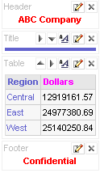
Result: Adding Header and Footer to New Reports
Results for new requests display header and footer by default

Slide 13
Summary
This module showed you how to:
  Make general configuration changes using instanceconfig.xml
  Administer Siebel Answers using instanceconfig.xml
  Administer Siebel Answers using XML message files

Slide 14
Lab
In the lab you will:
  Administer Siebel Answers using instanceconfig.xml
  Administer Siebel Answers using XML message files

